Slide 1

THINK BIGGER

Slide 2

Credit Card Fraud Detection

Slide 3
Approach
01
02
03
04
05
Model Build & Evaluation
Data Processing
Exploratory Data Analysis
Feature Engineering
Data Sampling

Slide 4
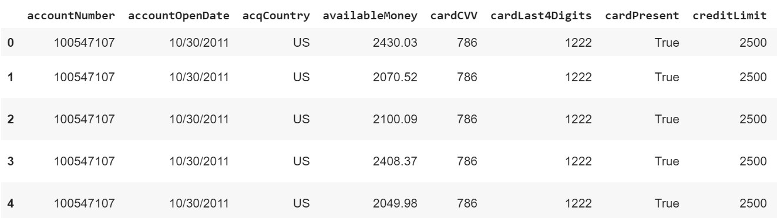
Data Processing
Data frame of the given data

Slide 5
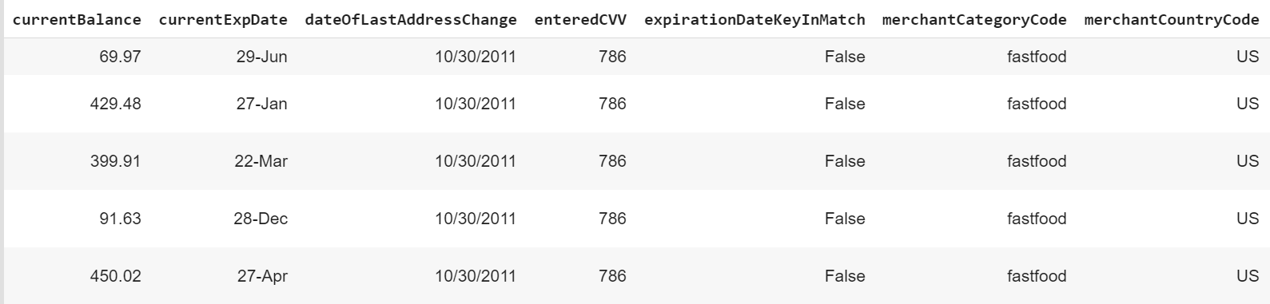
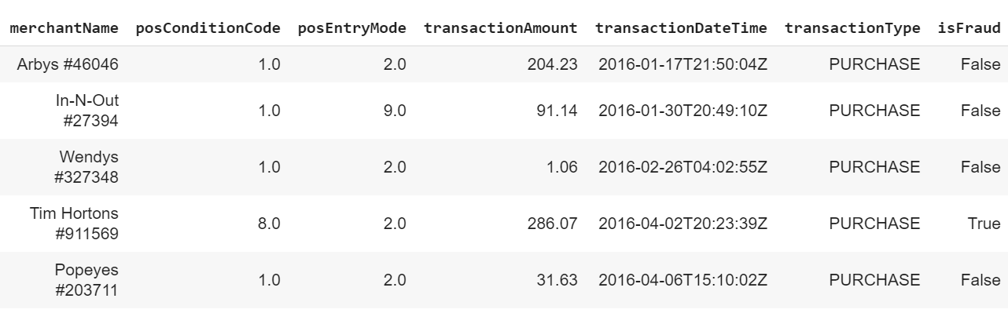
Data Processing

Slide 6
Data Processing
Label Encoding :
Used labelEncoder class from sklearn.preprocessing package.
Normalize data :
Used MinMaxScaler class from sklearn.preprocessing package.
Null Values : df.isnull( ).sum( )
Column Names | Number of Null Values
acqCountry | 1427
merchantCountryCode | 227
posConditionCode | 102
posEntryMode | 1279
transactionType | 225

Slide 7
Data Preprocessing
Outlier Detection :
Local Outlier Factor - from sklearn.neighbors
One Class SVM – from svm
Isolation Forest – from sklearn.ensemble
Most of the Banks and payment services using different anomaly scoring methods either using one anomaly score or averaging the scaled anomaly scores of some of anomaly scoring techniques to make sure not to lose any fraudulent transactions.
Box plots give us a good idea about outliers!!

Slide 8
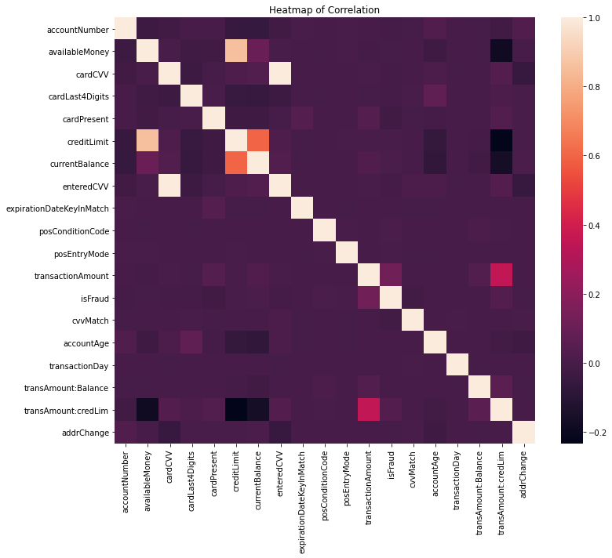
Exploratory Data Analysis
Heat Map

Slide 9
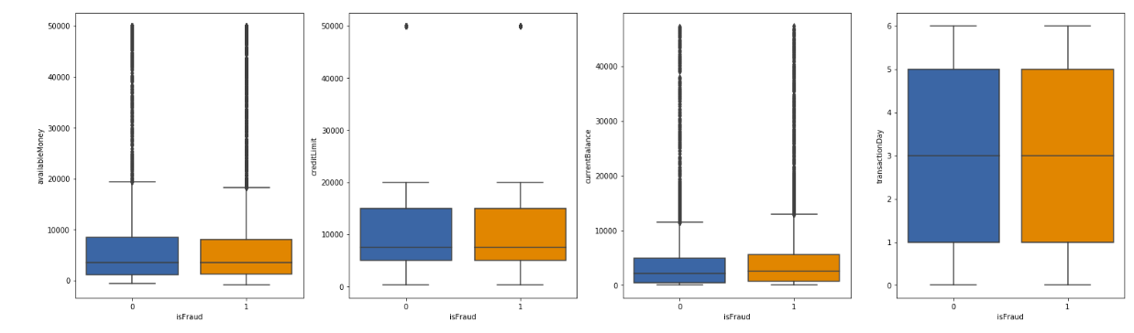
Exploratory Data Analysis
Box Plots

Slide 10
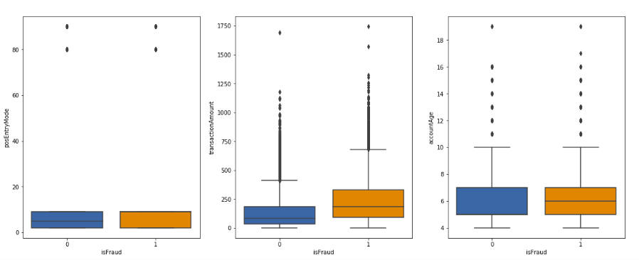
Exploratory Data Analysis
Box Plots

Slide 11
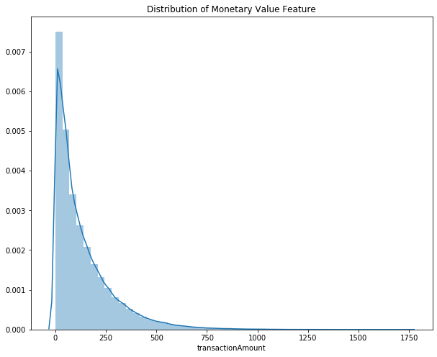
Exploratory Data Analysis
Distribution Plot

Slide 12
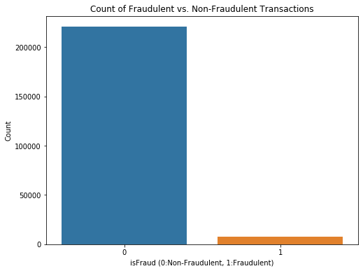
Exploratory Data Analysis
Distribution Plot

Slide 13
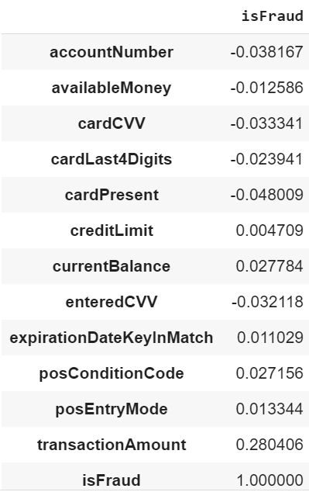
Exploratory Data Analysis
Correlation Matrix
Did not include all columns because I only wanted to focus on how each column is correlated to the ‘isFraud’ column.

Slide 14
Feature Engineering
Does the entered CVV match with the card CVV ?
How many days has it been since the last address change ?
Age of the account (in years) ?
Ratio of Transaction Amount to that of current balance
Ratio of Transaction Amount to that of credit Limit
Day of the week ( 0→ Monday)

Slide 15
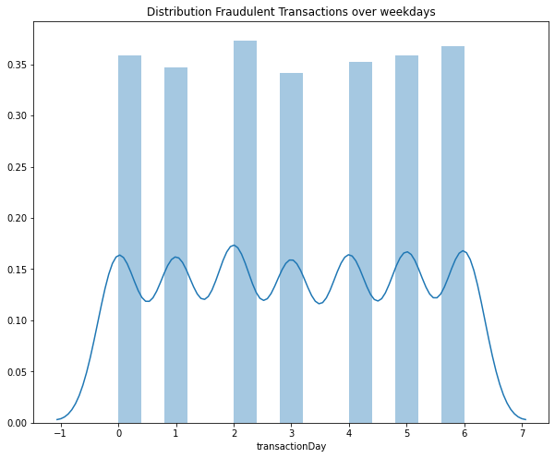
Feature Engineering

Slide 16
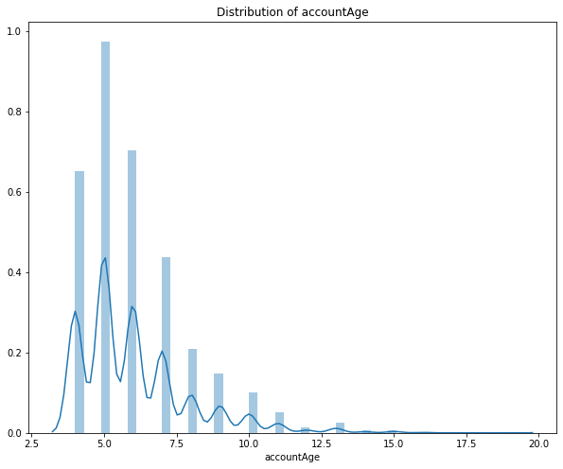
Feature Engineering

Slide 17
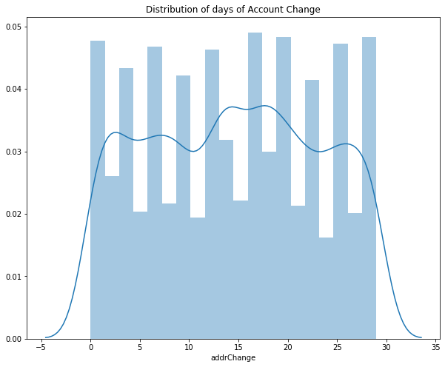
Feature Engineering

Slide 18
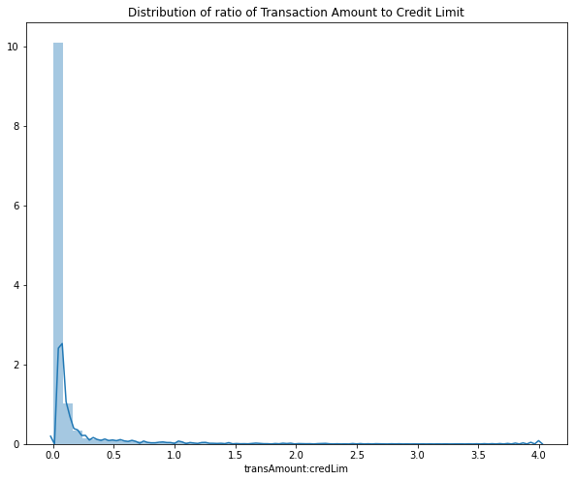
Feature Engineering

Slide 19
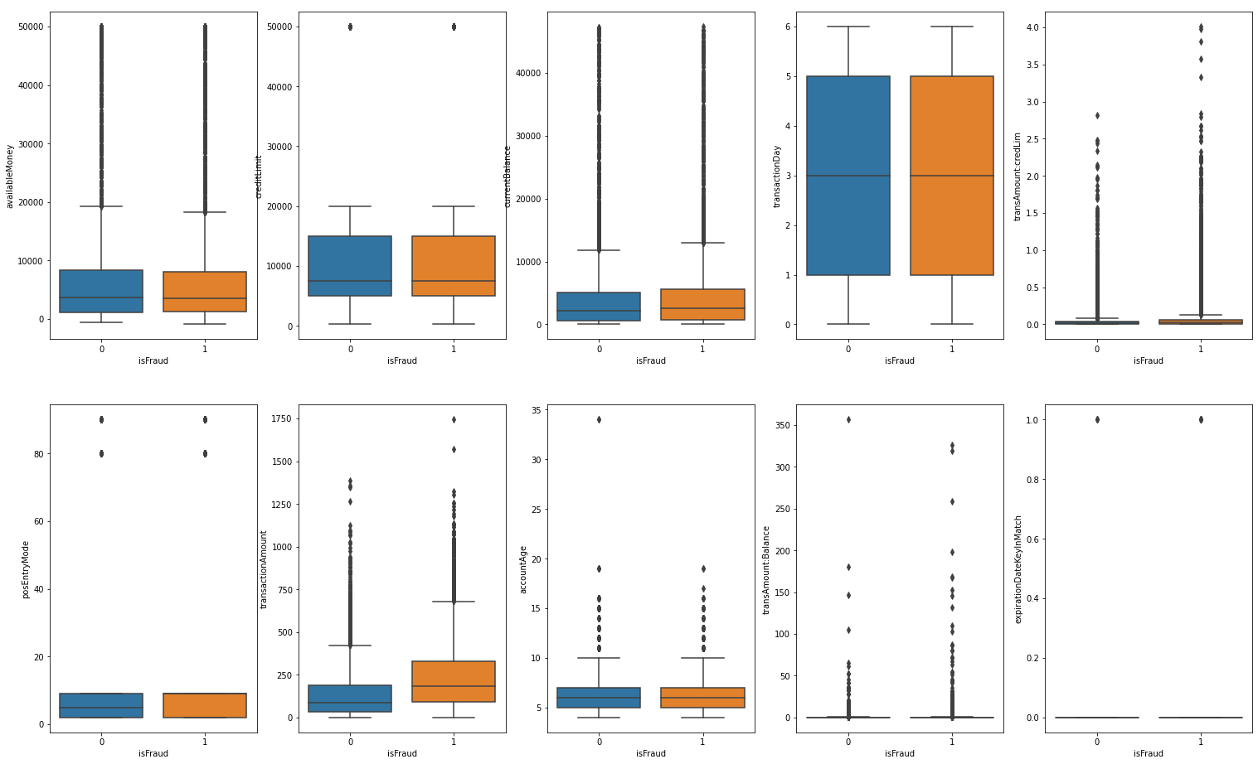
Feature Engineering

Slide 20
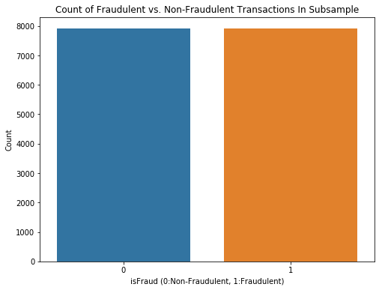
Data Sampling
Random Under-Sampling
And Random Over-Sampling
There were 220645 non-fraudulent transactions (96.538%) and 7912 fraudulent transactions (3.462%) – Severe skewness in the distribution!

Slide 21
Model Building and Evaluation
Random Forest Classifier – from sklearn.ensemble
Hyperparameters :
n_estimators – no. decision tress (default = 10)
max_depth – depth of each tree ( default = None i.e all pure leaves)
min_samples_split – min no. of samples required to split each node ( default = 2)
min_samples_leaf – min no. of samples required to be at the leaf (default = 1)
For an imbalanced classification problem, it is better not to use accuracy as a metric for model evaluation.
Instead we use metrics such as :
F1 Score
Recall
Precision
Precision Recall Tuning
Confusion Matrix

Slide 22
THANK YOU !!
- Naga Sri Vaishnavi Dhulipalla

